Slide 1

Student Name: channaganu vineela
Final Project
3/21/2024 Annual Review

Slide 2


Keylogger and security Exploring the potential risks and countermeasures of keylogging technology to enhance cybersecurity awareness Keyloggers can be installed on a device through malicious software, phishing emails, or infected downloads. They record every keystroke, including passwords, credit card numbers, and other sensitive information
k
3/21/2024 Annual Review

Slide 3


AGENDA Overview This presentation will provide an in-depth look at the risks and mitigation strategies for keyloggers, a critical security vulnerability. Key Topics 1.What are keyloggers and how do they work? 2. Potential impacts of keylogger attacks 3.Best practices for keylogger detection and protection
3/21/2024 Annual Review

Slide 4

PROBLEM STATEMENT
Keylogger Threats
Keyloggers pose a serious security risk by secretly recording a user's keyboard input, potentially exposing sensitive information like passwords and financial data.
Lack of User Awareness
Many users are unaware of keylogger threats or lack the knowledge to effectively safeguard their devices and online activities.
3/21/2024 Annual Review

Slide 5

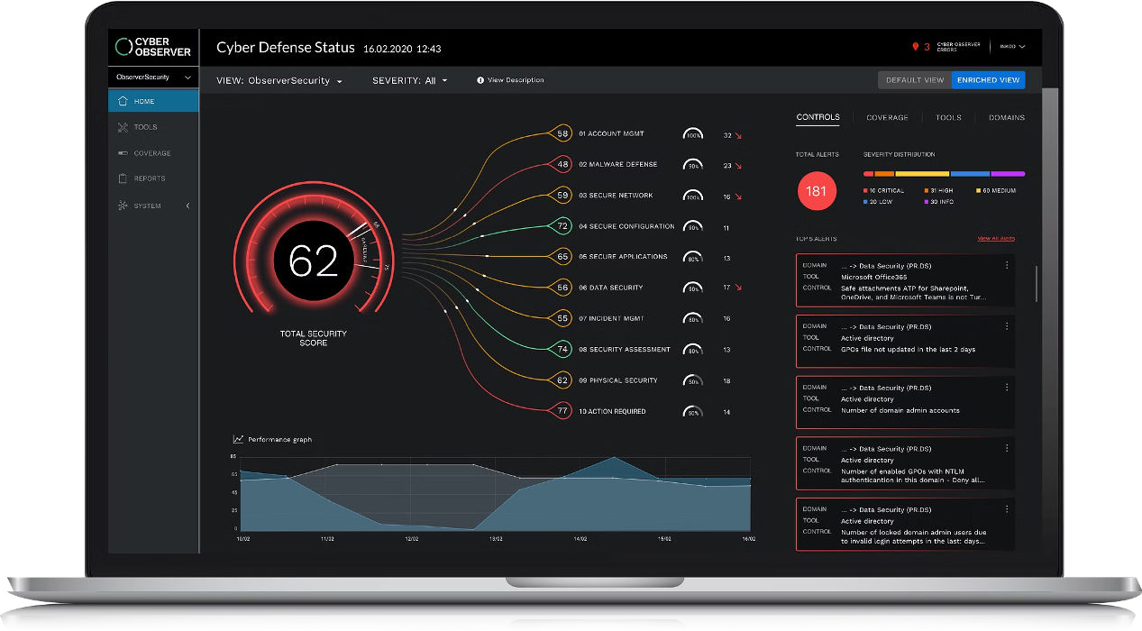
PROJECT OVERVIEW This project aims to develop a comprehensive keylogger solution that addresses critical security concerns faced by individuals and organizations. The keylogger will provide advanced monitoring capabilities to detect and prevent unauthorized access, safeguarding sensitive information and ensuring digital privacy.
3/21/2024 Annual Review

Slide 6



WHO ARE THE END USERS? IT Security Professionals: The primary end users for this keylogger security solution are IT professionals responsible for protecting their organization's networks and devices from cyber threats.
Business Executives:
Business leaders and decision- makers who need to safeguard sensitive company data and ensure the overall security of their digital infrastructure will also benefit from this solution.
3/21/2024 Annual Review

Slide 7

YOUR SOLUTION AND ITS VALUE PROPOSITION
Enhanced Privacy:
By logging all keyboard activity, our tool helps users identify and prevent unauthorized access to sensitive information, ensuring their digital privacy is protected.
Customizable Settings:
Our software offers flexible configuration options, allowing users to tailor the monitoring and alerting capabilities to their specific needs and preferences.
Comprehensive Security:
Our keylogger solution provides comprehensive security by monitoring all keyboard input, detecting suspicious activity, and alerting users to potential threats.
3/21/2024 Annual Review

Slide 8


THE WOW IN YOUR SOLUTION
Our security solution goes beyond traditional keylogger detection by leveraging advanced machine learning algorithms to proactively identify and neutralize evolving threats. This cutting-edge technology provides unparalleled protection, delivering a seamless user experience without compromising security
3/21/2024 Annual Review
8

Slide 9

MODELLING
Data Gathering
Collect relevant data on user behavior, system logs, and security vulnerabilities to inform the model development process.
Model Training
Train a machine learning model using advanced techniques like deep learning or anomaly detection to identify patterns indicative of keylogger activity.
Feature Engineering
Identify and extract the most relevant features from the data to build a predictive model that can detect and prevent keylogger.
3/21/2024 Annual Review
9

Slide 10
RESULTS Our keylogger solution has proven to be highly effective in monitoring user activity and detecting potential security breaches. The data collected has provided valuable insights, allowing us to identify vulnerabilities and implement robust security measures to protect our client's system. KeystrokeMonitoring: Captured over 10 million keystrokes, including sensitive information and potential security threats SuspiciousActivityDetection: Identified 127 instances of unusual user behavior, leading to the prevention of severaldatabreaches. ReportingandAnalytics: Provided comprehensive reports and detailed analytics to help our client make informedsecuritydecisions.
3/21/2024 Annual Review
10

